Slide 1
Cloud provider compare

Slide 2
Google cloud service
AWS cloud services
Microsoft azure

Slide 3
Compute

Slide 4
Compute service
Google cloud
vCPUs = 8
Memory = 32GB
OS = Windows server
Disk = 100GB
AWS cloud
vCPUs = 8
Memory = 32GB
OS = Windows server
Disk = 100GB
Microsoft azure
vCPUs = 8
Memory = 32GB
OS = Windows server
Disk = 200GB

Slide 5
Pricing (GCP)
Compute engine
vCPUs = 8
Memory = 32GB
OS = Windows server
Disk = 128GB
Summary payment per mount Instance + Disk
12,831.00 + 13,096.53 = 25,927.53 per month
311,130.36 Baht per year
*No upfront (Commit 1 year)

Slide 6
Pricing (AWS)
On-Demand = 398.80 USD per month (*12 = per year)
146,788.71 Baht per year
EC2 (Elastic Compute Cloud)
vCPUs = 8
Memory = 32GB
OS = Windows server
Disk = 100GB
Commit 1 year = 3,306.90 + (5.40 * 12) = 3,371.70 USD
103,420.15 Baht per year
Commit 3 years = 7,739.46 + (5.40 * 36) = 7,933.86 USD
243,355.29 Baht per 3 years

Slide 7
Pricing (MS azure)
On-Demand = 595.73 USD per month (*12 = per year)
219,273.92 Baht per year
Virtual machine
vCPUs = 8
Memory = 32GB
OS = Windows server
Disk = 200GB
Commit 1 year = 2,355.04 + (268.69 * 12) = 5,579.32 USD
171,134.48 Baht per year
Commit 3 years = 4,709.90 + (268.69 * 36) = 14,382.74 USD
441,161.78 Baht per 3 years

Slide 8
SQL server

Slide 9
SQL server
Google cloud
vCPUs = 8
Memory = 32GB
OS = Windows server
Disk = 100GB
Backup = 100GB
AWS cloud
vCPUs = 8
Memory = 32GB
OS = Windows server
Disk = 100GB
Backup = 100GB
Microsoft azure
vCPUs = 8
Memory = 32GB
OS = Windows server
Disk = 200GB

Slide 10
Pricing (GCP)
Cloud SQL
vCPUs = 8
Memory = 32GB
OS = Windows server
Disk = 300GB
On-Demand = 35,365.76 THB per month (*12 = per year)
424,389.12 Baht per year
*No upfront (Commit 1 year)

Slide 11
Pricing (AWS)
Commit 1 year = 16,404.00 + (108.80 * 12) = 17,709.6 USD
543,206.56 Baht 1 year
Amazon RDS
vCPUs = 8
Memory = 32GB
OS = Windows server
Disk = 100GB (SSD gp2)
Backup = 100GB
Commit 3 year = 43,467.00 + (108.80 * 36) = 47,383.8 USD
1,453,403.30 Baht 3 year

Slide 12
Pricing (MS azure)
Commit 1 year = 3,018.00 + (852.69 * 12) = 13,250.28 USD
406,425.84 Baht per year
Virtual machine
vCPUs = 8
Memory = 32GB
OS = Windows server
Disk = 300GB
Commit 3 year = 5,832.06 + (852.69 * 36) = 36,528.90 USD
1,120,450.95 Baht per year

Slide 13
Serverless

Slide 14
Pricing (GCP)
Cloud run
Request / month = 1,000,000
Memory = 1GB
Request time / request = 5000ms
On-demand = 13.14 USD / month
395.05 Baht per month

Slide 15
Pricing (AWS)
AWS Lambda
Request / month = 1,000,000
Memory = 1GB
Request time / request = 5000ms
On-demand = 76.67 USD / month
2,351.70 Baht per month

Slide 16
Pricing (MS azure)
Azure Functions
Request / month = 1,000,000
Memory = 1GB
Request time / request = 5000ms
On-demand = 73.60 USD / month
2,257.53 Baht per month

Slide 17
Microsoft azure have support tier
Included 0.00 USD
Developer 29.00 USD
Standard 100.00 USD
Professional direct 1,000.00 USD
*** Include to monthly cost ***

Slide 18
Appendix

Slide 19



Provider services

Slide 20


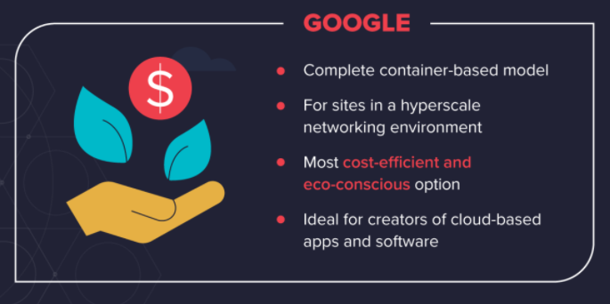
Provider strengths

Slide 21
Reference
https://cloud.google.com/products/calculator
https://azure.microsoft.com/en-au/pricing/calculator
https://calculator.aws
https://www.varonis.com/blog/aws-vs-azure-vs-google

